Slide 1
Linear Algebra

Slide 2
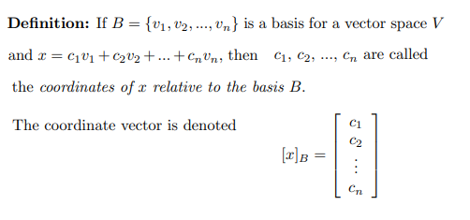
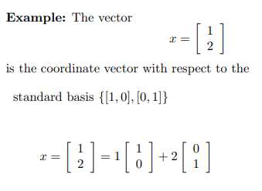
Change of basis

Slide 3
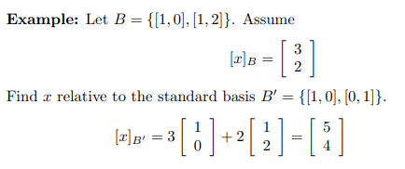
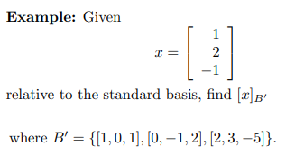

Slide 4
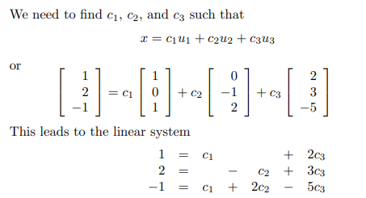
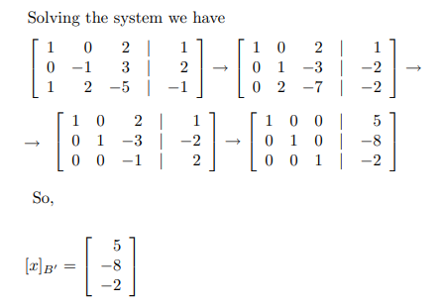

Slide 5
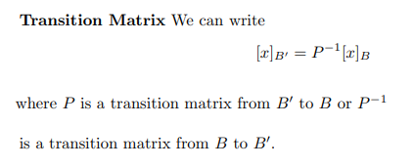
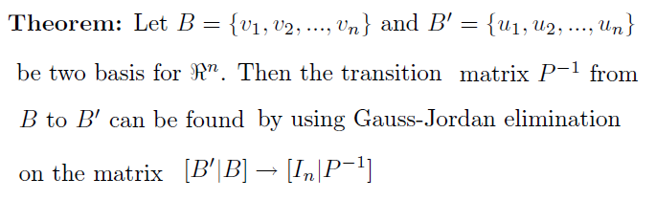

Slide 6
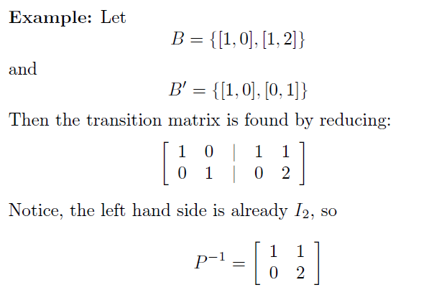
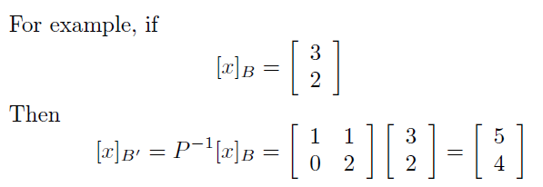

Slide 7
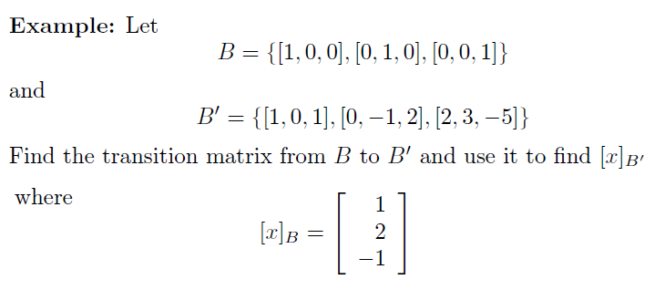

Slide 8
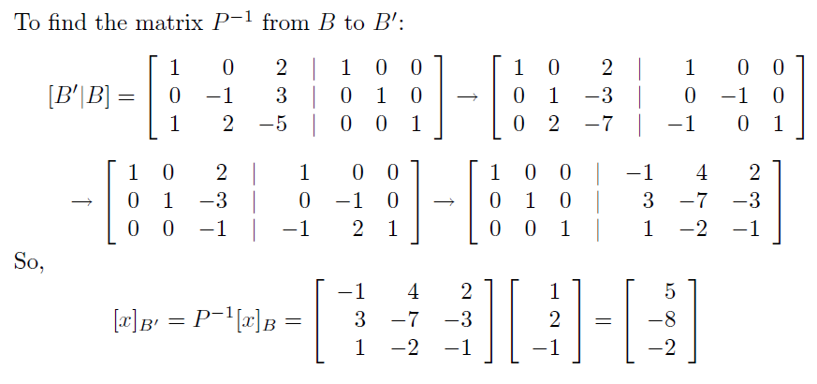

Slide 9
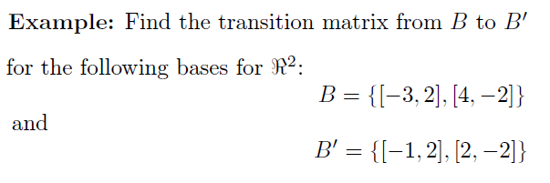

Slide 10
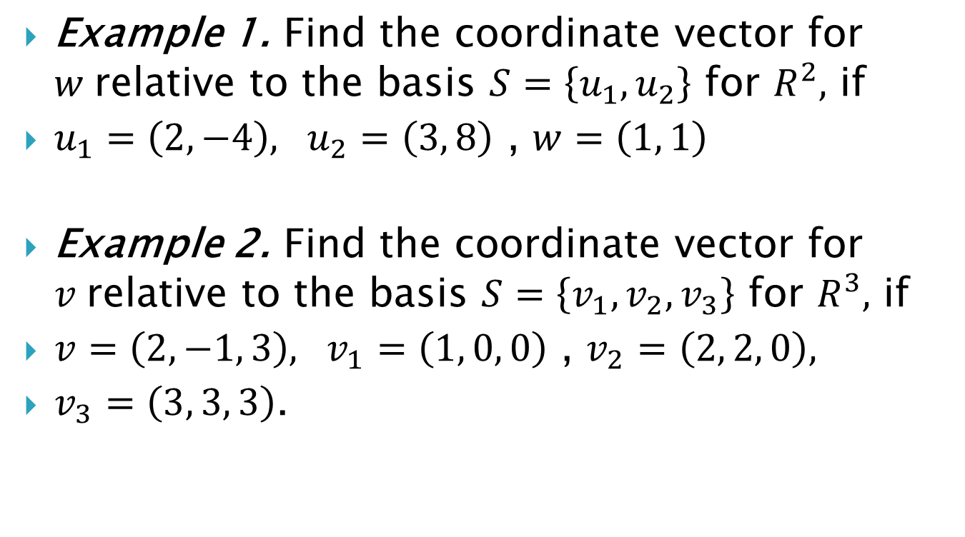
Example 1. Find the coordinate vector for $w$relative to the basis $S=\left\{u_{1}, u_{2}\right\}$ for $R^{2},$ if
$u_{1}=\left(2, −4\right), u_{2}=\left(3, 8\right)$ , $w=\left(1, 1\right)$
Example 2. Find the coordinate vector for $v$relative to the basis $S=\left\{v_{1}, v_{2}, v_{3}\right\}$ for $R^{3},$ if
$v=\left(2, −1, 3\right), v_{1}=\left(1, 0, 0\right)$ , $v_{2}=\left(2, 2, 0\right),$
$v_{3}=\left(3, 3, 3\right)$.

Slide 11
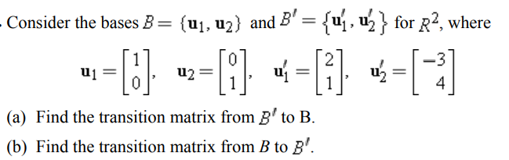
Example 3.

Slide 12
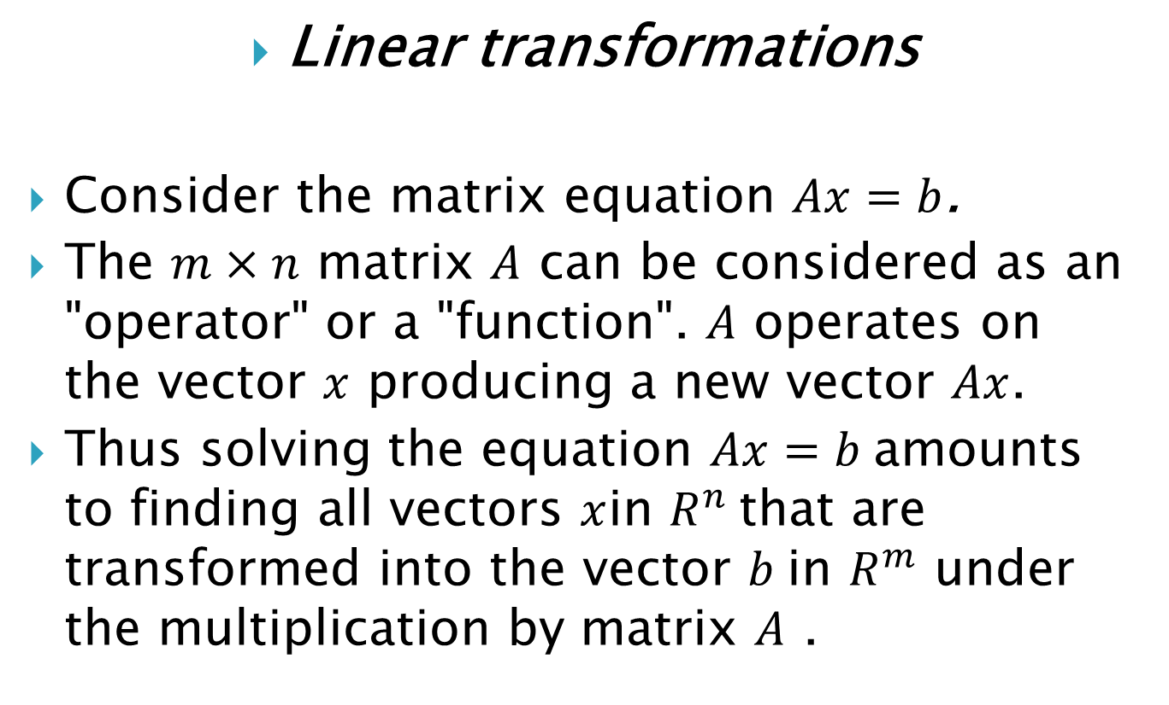
Linear transformations
Consider the matrix equation $Ax=b$.
The $m×n$ matrix $A$ can be considered as an "operator" or a "function". $A$ operates on the vector $x$ producing a new vector $Ax$.
Thus solving the equation $Ax=b$amounts to finding all vectors $x$in $R^{n}$that are transformed into the vector $b$in $R^{m}$ under the multiplication by matrix $A$ .

Slide 13
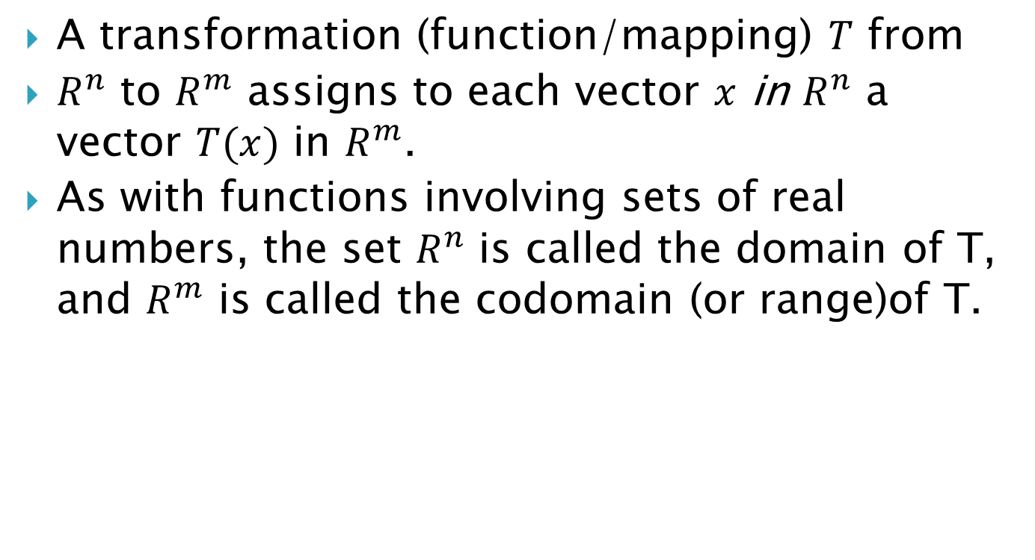
A transformation (function/mapping) $T$ from
$R^{n}$ to $R^{m}$ assigns to each vector $x$ in $R^{n}$ a vector $T(x)$ in $R^{m}$.
As with functions involving sets of real numbers, the set $R^{n}$ is called the domain of T, and $R^{m}$ is called the codomain (or range)of T.

Slide 14
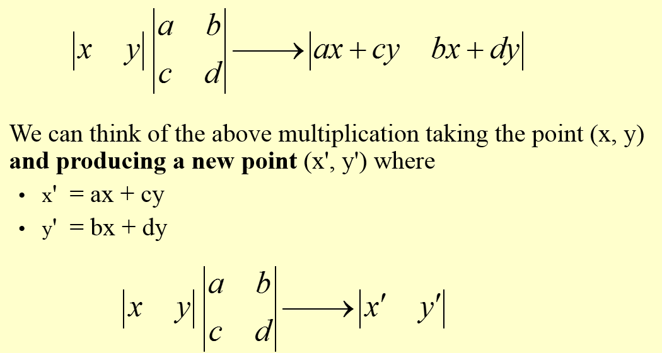

Slide 15
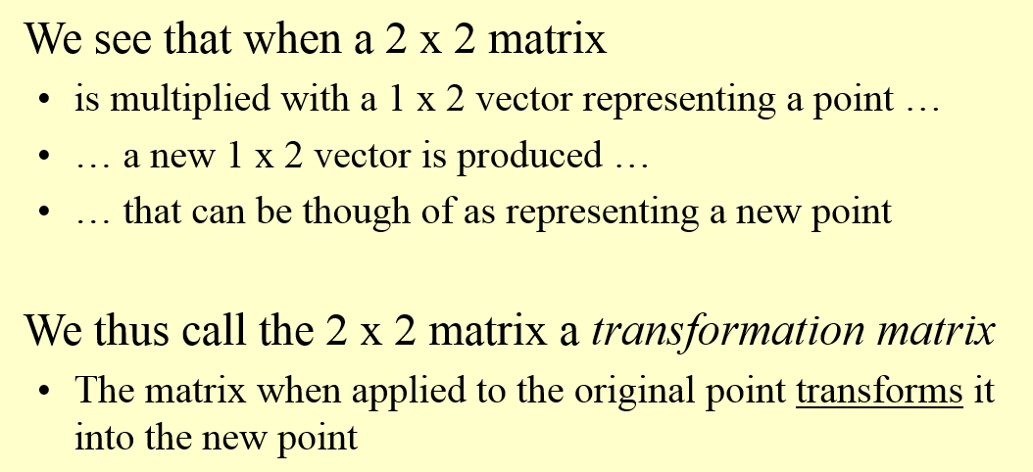

Slide 16
Transformations with Matrices
Reflections
A reflection, or flip, is a transformation that creates symmetry.
You can use matrix multiplication to graph reflections in the coordinate plane.
There are four reflection matrices you are responsible for knowing.

Slide 17
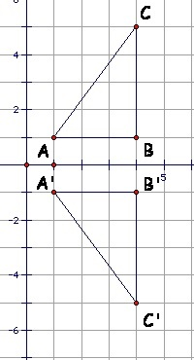
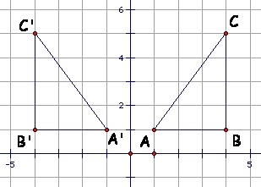
Reflections
Reflection in the y-axis Reflection in the x-axis

Slide 18
Reflections
Reflection in the line y = x Reflection in the line y = -x

Slide 19

Reflections
Example 1: Given triangle ABC with A (–4, 1), B (– 2, 5) and C (0, 2), reflect the triangle across the y-axis. Then, sketch the image.
A B C

Slide 20
Reflections
Example 1: Given triangle ABC with A (–4, 1), B (– 2, 5) and C (0, 2), reflect the triangle across the y-axis. Then, sketch the image.
A B C
y-axis reflection matrix

Slide 21
Reflections
Example 1: Given triangle ABC with A (–4, 1), B (– 2, 5) and C (0, 2), reflect the triangle across the y-axis. Then, sketch the image.
A B C
A’ B’ C’
y-axis reflection matrix

Slide 22
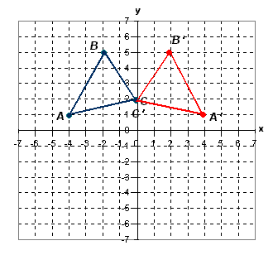
Reflections

Slide 23
